Slide 1
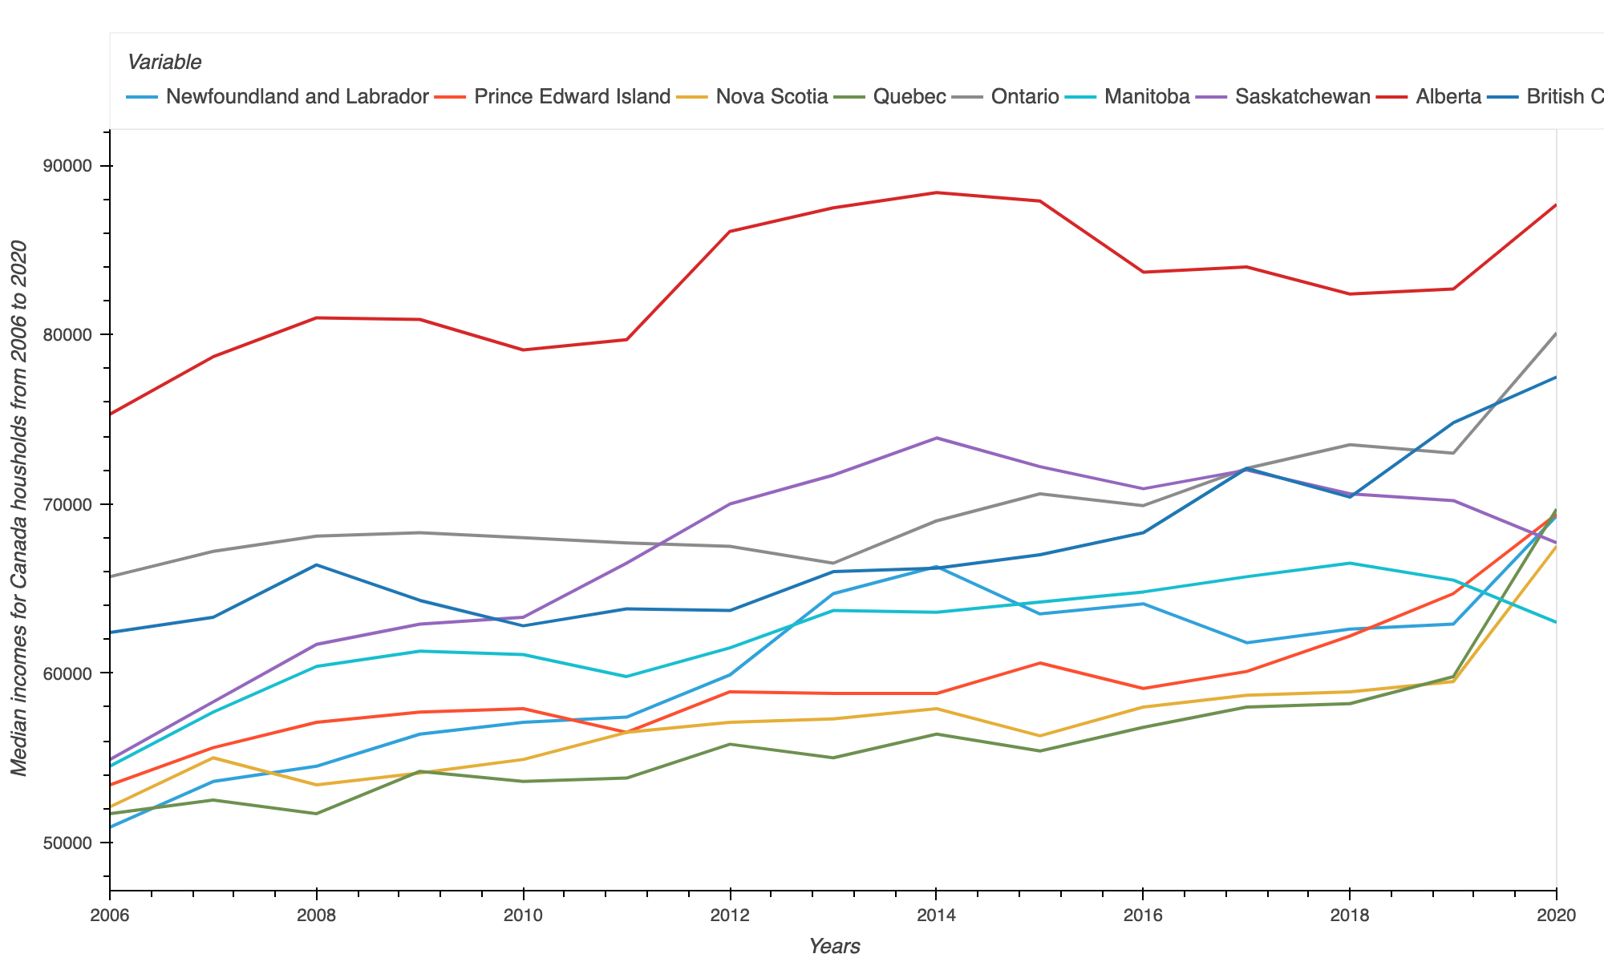
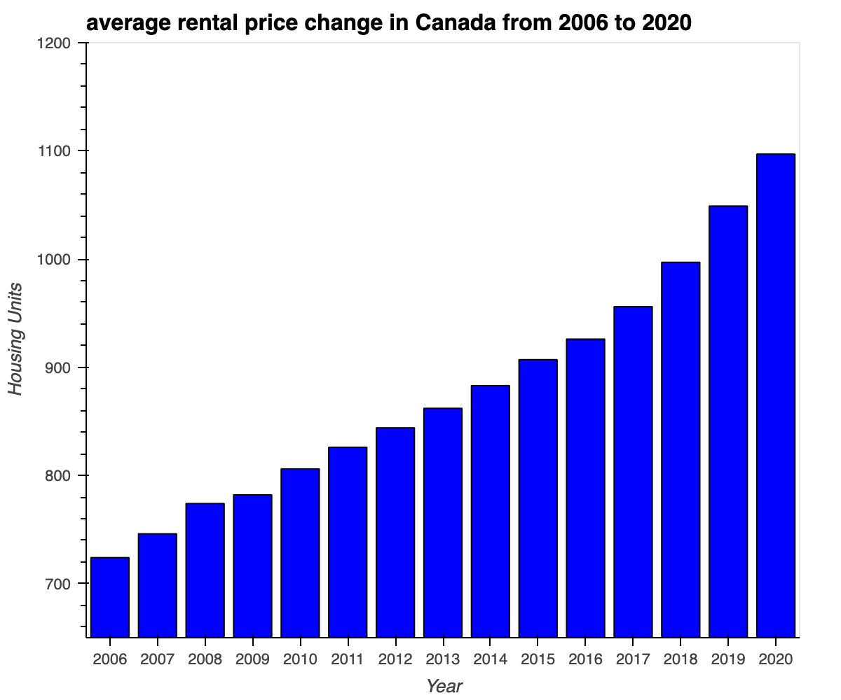
Average rent prices in Canada There is an increasing trend in the current Rental market and in cities like Toronto and Vancouver rental prices have spiked up to 30% in 2022
Median Income in Canada On Average every Canadian Personal income ranges between 50K-80K per year. If this is compared to the current rental market, Every household is almost spending 30% to 40% of their income on rental and leasing purposes

Slide 2
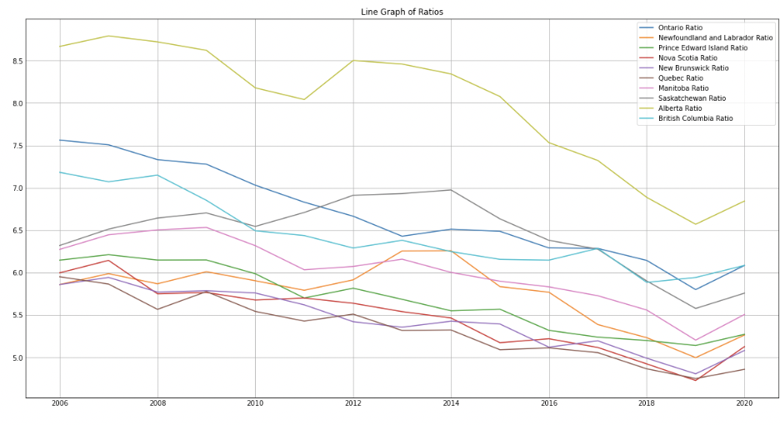
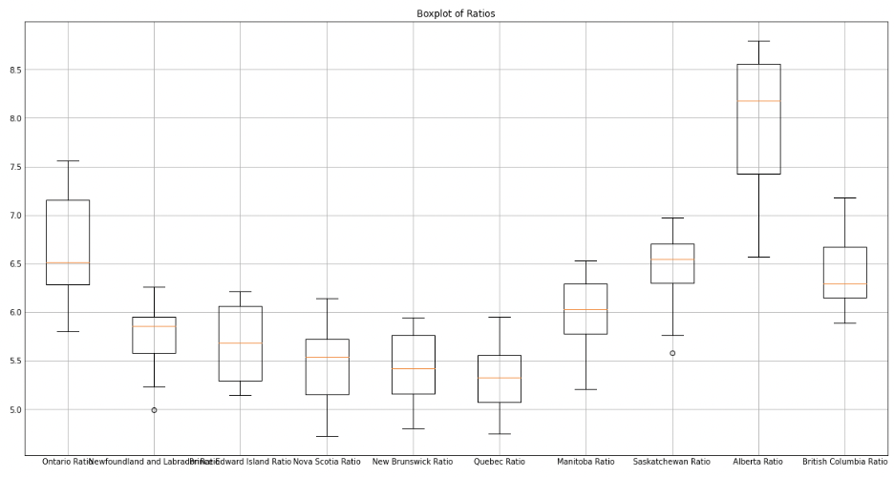
Opportunity – Price & Rent Ratio
Price to Rent ratio is one of the important factors that could be used by an individual to make decisions.
file:///Users/akshaynyamala/Documents/Project_1/housing_price_map.html
Price to rent ratio | Indication
1-15 | Most likely better to buy than rent
16-20 | Typically better to buy than rent
21+ | Better to rent than buy

